Slide 1
Capstone Project 1 Hotel Booking Analysis
Presented by
Ashutosh Kumar Mishra

Slide 2
Contents
1. Objective
2. Summary
3. Problem Statement
4. Business Objective
5. Description Of Data
6. Data Cleaning
7. Data Visualization, Storytelling & Experimenting with charts : Understand the relationships between variables
8. Solution To Business Objective
9. Conclusion

Slide 3
Objective
The objectives of hotel booking analysis are as follows:
Understand Guest Preferences: Hotel booking analysis aims to gain insights into guest preferences, including their preferred room types, amenities, services, and booking channels. By understanding these preferences, hotels can tailor their offerings to meet customer expectations and provide a personalized experience.
Identify High-Demand Periods: Analysis of booking data helps identify peak seasons, holidays, and other periods of high demand. This information allows hotels to optimize pricing strategies, manage inventory effectively, and allocate resources efficiently during busy periods.
Optimize Room Allocation: By analyzing booking patterns, hotels can optimize room allocation strategies. This includes identifying the most popular room types, determining the optimal room mix, and allocating rooms based on guest preferences, ensuring maximum occupancy and revenue generation.
Forecast Demand: Accurate demand forecasting is crucial for hotels to plan staffing, inventory, and revenue management strategies effectively. Hotel booking analysis helps predict future booking trends, allowing hotels to make informed decisions and adjust their operations accordingly.
Reduce Cancellations: Cancellations can negatively impact hotel revenue and occupancy rates. By analyzing cancellation patterns and identifying the underlying reasons, hotels can implement strategies to minimize cancellations, such as flexible cancellation policies, targeted marketing campaigns, and improved customer service.
Maximize Revenue: Hotel booking analysis helps identify revenue opportunities and optimize pricing strategies. By understanding price sensitivity, demand patterns, and market trends, hotels can set optimal room rates, implement dynamic pricing strategies, and identify cross-selling and upselling opportunities to maximize revenue.
Enhance Customer Satisfaction: Analysis of guest feedback and reviews can provide insights into areas for improvement and enhance overall customer satisfaction. By addressing common pain points, hotels can enhance the guest experience and build a positive reputation, leading to repeat bookings and positive word-of-mouth recommendations.
Evaluate Marketing Effectiveness: Hotel booking analysis allows evaluation of marketing and promotional campaigns' effectiveness. By tracking booking sources, analyzing conversion rates, and measuring return on investment, hotels can optimize their marketing strategies and allocate resources to the most successful channels.
Overall, the objective of hotel booking analysis is to leverage data-driven insights to optimize operations, improve revenue, enhance guest satisfaction, and drive positive business impact in the highly competitive hospitality industry.

Slide 4
Summary
This project is related to Hotel Booking having two hotel description i.e City Hotel and Resort Hotel. In this dataset contains total rows 119390 and 32 columns. In this we divide data manipulation workflow in three category Data Collection ,Data cleaning and manipulation and EDA(Exploratory Data Analysis).As Further moved i.e Data collections first step to find different columns which is done by coding Head(), tail(), info(), describe(), columns() and some others method used for data collections, some of the columns name is updated here i.e hotel,is_canceled,lead_time,arrival_date_year,arrival_date_month,arrival_date_week_number,arrival_date_day_of_month,stays_in_weekend_nights.As we further moved we find unique value of each columns and generate a list in tabular form and also check the dataset type of each columns’ find some columns not in accurate data types which correct it later done in Data cleaning part and as well as duplicates data items must be removed as we find duplicates items equal to 87396 which is dropped from dataset later.
Before visualize any data from the data set we have to do data wrangling. For that, we are checked the null value of all the columns. After checking, when we are getting a column which has more number of null values, dropped that column by using the 'drop' method. In this way, we are dropped the 'company' column. When we are find minimal number of null values, filling these null values with necesary values as per requirement by using .fillna()
Different charts are used for data visualization so that better insights and Business objective is attained.

Slide 5
Problem Statement
Have you ever wondered when the best time of year to book a hotel room is? Or the optimal length of stay in order to get the best daily rate? What if you wanted to predict whether or not a hotel was likely to receive a disproportionately high number of special requests? This hotel booking dataset can help you explore those questions! This data set contains booking information for a city hotel and a resort hotel, and includes information such as when the booking was made, length of stay, the number of adults, children, and/or babies, and the number of available parking spaces, among other things. All personally identifying information has been removed from the data. Explore and analyze the data to discover important factors that govern the bookings.

Slide 6
Business Objective
Analyse the data on bookings of City Hotel and Resort Hotel to gain insights on the different factors that affect the booking. This is undertaken as an individual project.

Slide 7
Description Of Data
The columns and the data it represents are listed below:
1.hotel : Name of the hotel (Resort Hotel or City Hotel)
2.is_canceled : If the booking was canceled (1) or not (0)
3.lead_time: Number of days before the actual arrival of the guests
4.arrival_date_year : Year of arrival date
5.arrival_date_month : Month of month arrival date
6.arrival_date_week_number : Week number of year for arrival date
7.arrival_date_day_of_month : Day of arrival date
8.stays_in_weekend_nights : Number of weekend nights (Saturday or Sunday) spent at the hotel by the guests.
8.stays_in_week_nights : Number of weeknights (Monday to Friday) spent at the hotel by the guests.
9.adults : Number of adults among guests
10.children : Number of children among guests
11.babies : Number of babies among guests
12.meal : Type of meal booked
13.country : Country of guests
14.market_segment : Designation of market segment
15.distribution_channel : Name of booking distribution channel
16.is_repeated_guest : If the booking was from a repeated guest (1) or not (0)

Slide 8
17.previous_cancellations : Number of previous bookings that were cancelled by the customer prior to the current booking
18.previous_bookings_not_canceled : Number of previous bookings not cancelled by the customer prior to the current booking
19.reserved_room_type : Code of room type reserved
20.assigned_room_type : Code of room type assigned
21.booking_changes : Number of changes/amendments made to the booking
22.deposit_type : Type of the deposit made by the guest
23.agent : ID of travel agent who made the booking
24.company : ID of the company that made the booking
25.days_in_waiting_list : Number of days the booking was in the waiting list
26.customer_type : Type of customer, assuming one of four categories
27.adr : Average Daily Rate, as defined by dividing the sum of all lodging transactions by the total number of staying nights
28.required_car_parking_spaces : Number of car parking spaces required by the customer
29.total_of_special_requests : Number of special requests made by the customer
30.reservation_status : Reservation status (Canceled, Check-Out or No-Show)
31.reservation_status_date : Date at which the last reservation status was updated

Slide 9
Data Cleaning
Data cleaning is a crucial step in the data analysis process that involves identifying and correcting or removing errors, inconsistencies, and inaccuracies in the dataset. The objective of data cleaning is to ensure that the data is accurate, complete, and reliable for analysis. Here is a brief overview of the data cleaning process:
Handling Missing Values: Missing values are common in datasets and can occur due to various reasons. Data cleaning involves identifying missing values and deciding how to handle them. This can include imputing missing values with appropriate techniques such as mean, median, or mode, or removing records or variables with excessive missing data.
Removing Duplicates: Duplicates occur when there are identical or very similar records in the dataset. Data cleaning involves identifying and removing duplicate records to avoid redundancy and ensure data integrity.
Dealing with Inconsistent Values: Inconsistent values can arise due to data entry errors or different conventions used during data collection. Data cleaning involves standardizing and correcting inconsistent values, such as formatting dates, ensuring consistent units of measurement, and resolving discrepancies in categorical variables.
Addressing Outliers: Outliers are extreme values that deviate significantly from the rest of the data. Data cleaning includes identifying and handling outliers appropriately. Depending on the analysis context, outliers can be corrected, removed, or treated separately to avoid distorting the analysis results.
Standardizing and Transforming Data: Data cleaning may involve standardizing variables by converting them to a common scale or transforming variables to meet the assumptions of the analysis techniques to be applied. This can include log transformations, scaling, or normalization of variables.
Validating Data Integrity: Data cleaning also involves validating data integrity by performing sanity checks and cross-validating the data against external sources or known benchmarks. This helps ensure that the data accurately represents the real-world phenomenon under study.
Documentation and Record-keeping: Throughout the data cleaning process, it is essential to document the steps taken, decisions made, and any changes made to the dataset. This documentation helps maintain transparency, reproducibility, and enables others to understand and replicate the data cleaning process.

Slide 10
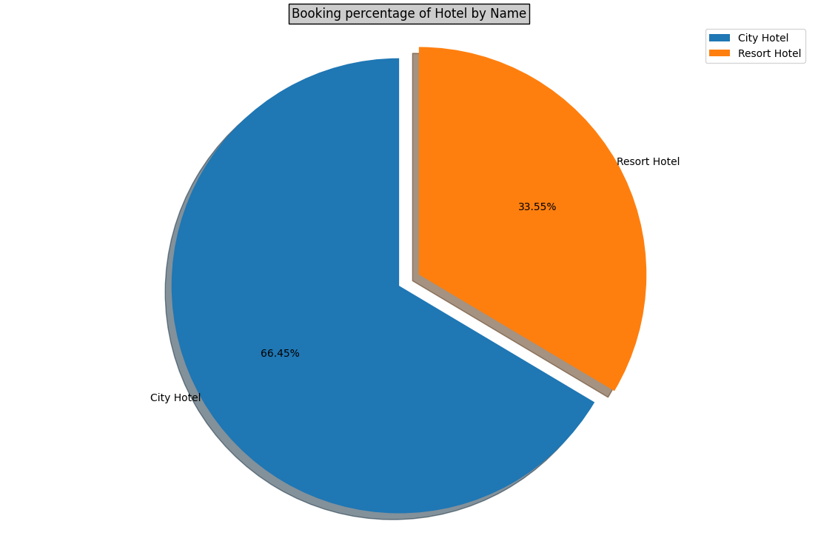
Data Vizualization, Storytelling & Experimenting with charts :Understand the relationships between variables
Chart 1 - Booking Percentage of Hotel by Name using Pie Chart

Slide 11
1. Why did you pick the specific chart?
To present the data that in which hotel more booking have been done`
2. What is/are the insight(s) found from the chart?
Here, we found that the booking number is Higher in City Hotel which is 61.12% than Resort Hotel which is 38.87%. Hence we can say that City hotel has more consumption
3. Will the gained insights help creating a positive business impact?
Are there any insights that lead to negative growth? Justify with specific reason.
Yes, for both Hotels, this data making some positive business impact : -
City Hotel :- Provided more services to attract more guest to increase more revenue.
Resort Hotel :- Find solution to attract guest and find what city hotel did to attract guest.

Slide 12
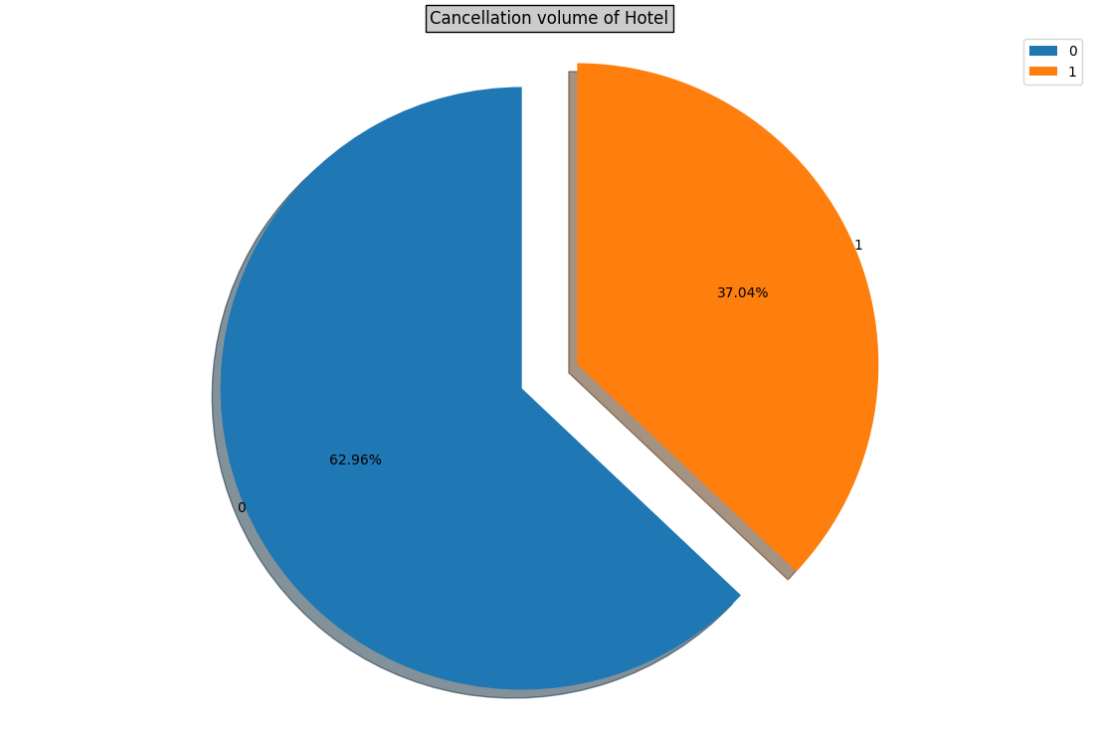
chart 2-Pie chart on Cancellation Value of Hotel Booking by cancellation status

Slide 13
1. Why did you pick the specific chart?
In this chart, we presented the cancellation rate of the hotels booking
2. What is/are the insight(s) found from the chart?
Here, we found that overall more than 25% of booking got cancellation
3. Will the gained insights help creating a positive business impact?
Are there any insights that lead to negative growth? Justify with specific reason.
Here, we can see, that more than 27% booking getting cancelled.
Solution: We can check the reason of cancellation of a booking & need to get this sort on business level

Slide 14
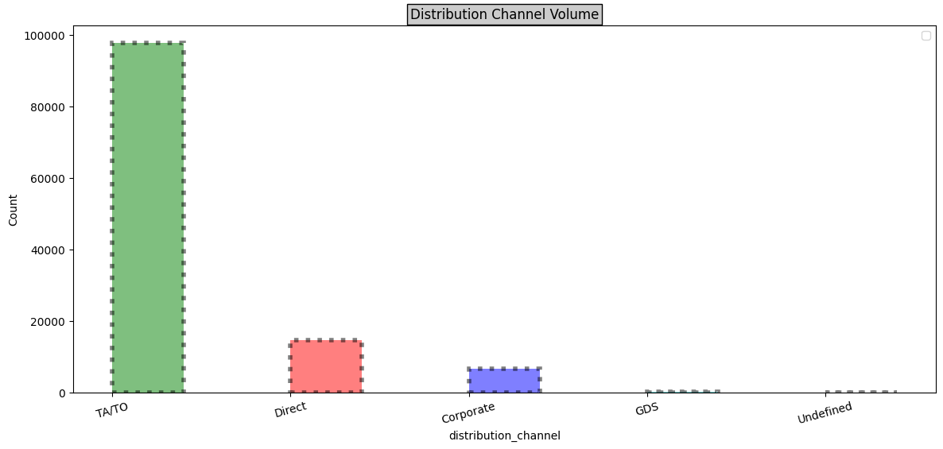
Chart 3 – bar chart of hotel booking volume by Distribution channel

Slide 15
1. Why did you pick the specific chart?
The following chart represent maximum volume of booking done through which channel to represent the numbers in descending order we chose bar graph.
2. What is/are the insight(s) found from the chart?
As clearly seen TA/TO(Tour of Agent & Tour of operator) is highest, recommending to continue booking through TA/TO
3. Will the gained insights help creating a positive business impact?
Are there any insights that lead to negative growth? Justify with specific reason.
Yes this shows positive business impact.
Higher the number of TA/TO will help to increase the revenue generation of Hotel.

Slide 16
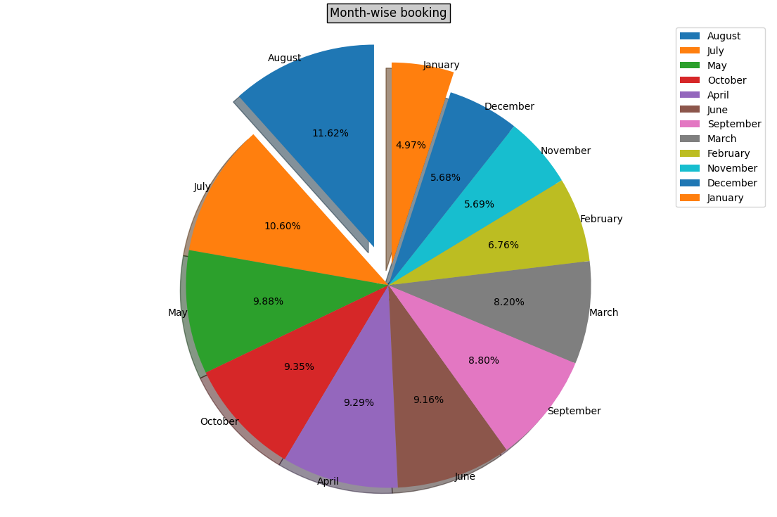
Chart 4 –Booking Distribution By Month In a Pie Chart

Slide 17
1. Why did you pick the specific chart?
To show the percentage share of booking in each month,on overall level
2. What is/are the insight(s) found from the chart?
The above percentage shows month May, July and Aug are the highest booking months due to holiday season. Recommending aggressive advertisement to lure more and more customers.
3. Will the gained insights help creating a positive business impact?
Are there any insights that lead to negative growth? Justify with specific reason.
Yes, with increased volume of visitors will help hotel to manage revenue in down time, will also help employee satisfaction and retention.

Slide 18
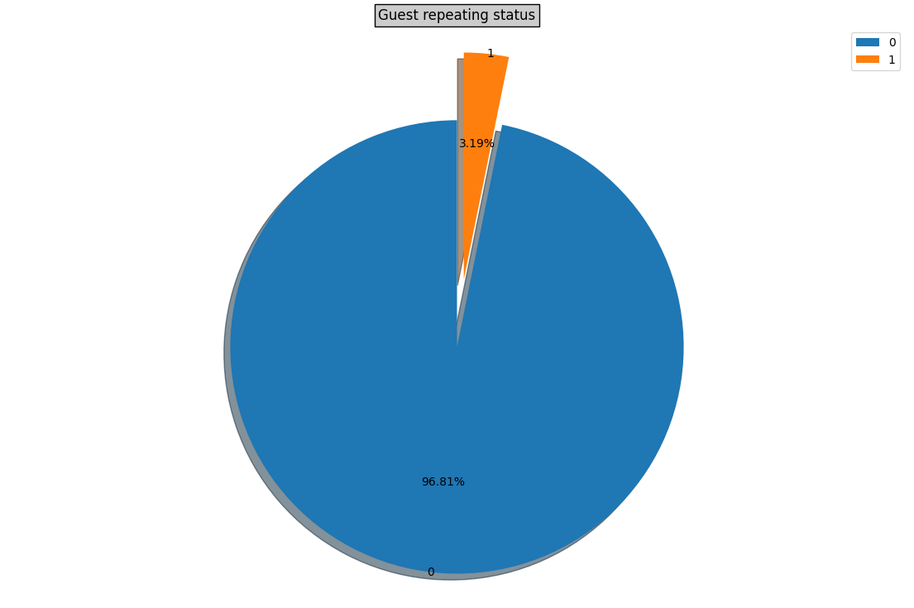
Chart 5-guest Repeating status in pie chart

Slide 19
1. Why did you pick the specific chart?
To show the percentage share of repeated & non-repeated guests.
2. What is/are the insight(s) found from the chart?
Here, we can see that the number of repeated guests is very less as compared to overall guests
3. Will the gained insights help creating a positive business impact?
Are there any insights that lead to negative growth? Justify with specific reason.
We can give alluring offers to non-repetitive customers during Off seasons to enhance revenue

Slide 20
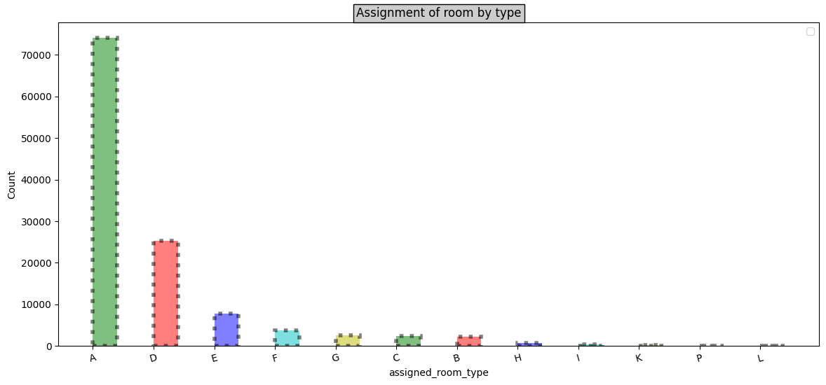
Chart 6 - Room Assignment by Type in a Bar Chart

Slide 21
1. Why did you pick the specific chart?
To show distribution by volume, which room is allotted.
2. What is/are the insight(s) found from the chart?
This chart shows room type 'A' is most preferred by guest.
3. Will the gained insights help creating a positive business impact?
Are there any insights that lead to negative growth? Justify with specific reason.
Yes, Positive impact because 'A','D','E' is more preferred by guest due to better services offered in room type

Slide 22
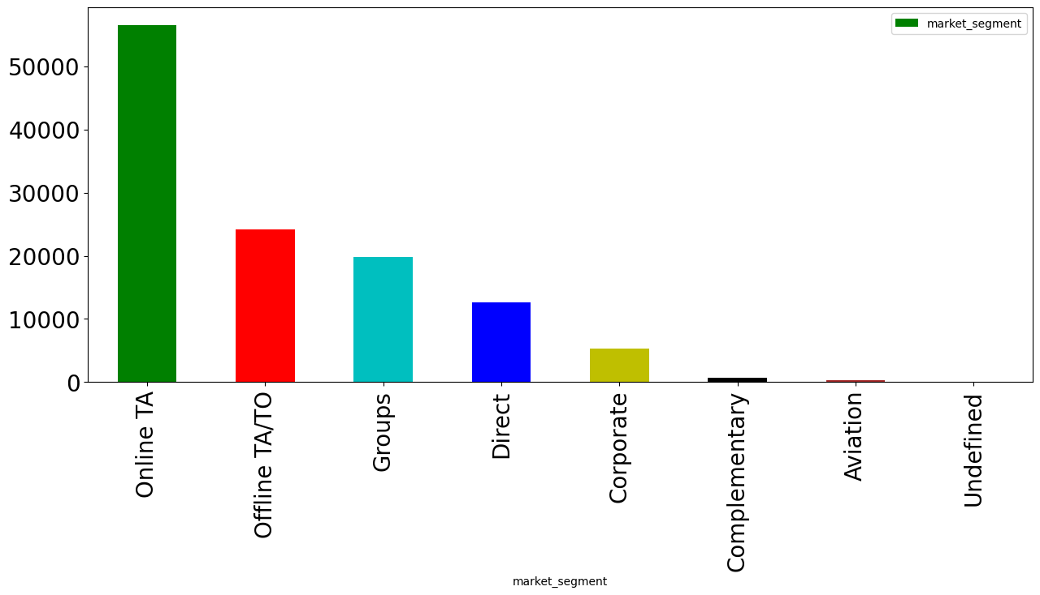
Chart - 7 - A bar chart to visualize the total number of guests by month

Slide 23
1. Why did you pick the specific chart?
In this chart, we have seen market segment by which hotel has booked
2. What is/are the insight(s) found from the chart?
Online TA has been used most frequently to book hotel by the guest.
3. Will the gained insights help creating a positive business impact?
Are there any insights that lead to negative growth? Justify with specific reason.
Yes, it is creating positive business impact that guests are using Online TA market segment as most prefered to book hotels.

Slide 24
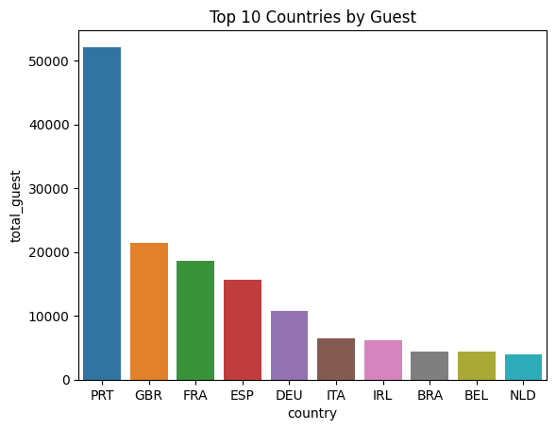
Chart 8- Top 10 Countries by Guest in a Bar Plot

Slide 25
1. Why did you pick the specific chart?
We have seen that mostly from which country Guests is coming
Chart is showing for top 10 country
2. What is/are the insight(s) found from the chart?
As we can see, that maximum guest is coming from Portugal
3. Will the gained insights help creating a positive business impact?
Are there any insights that lead to negative growth? Justify with specific reason.
We can do more advertising & can provide attractive offers to Portugal guests to enhance the customer volume

Slide 26
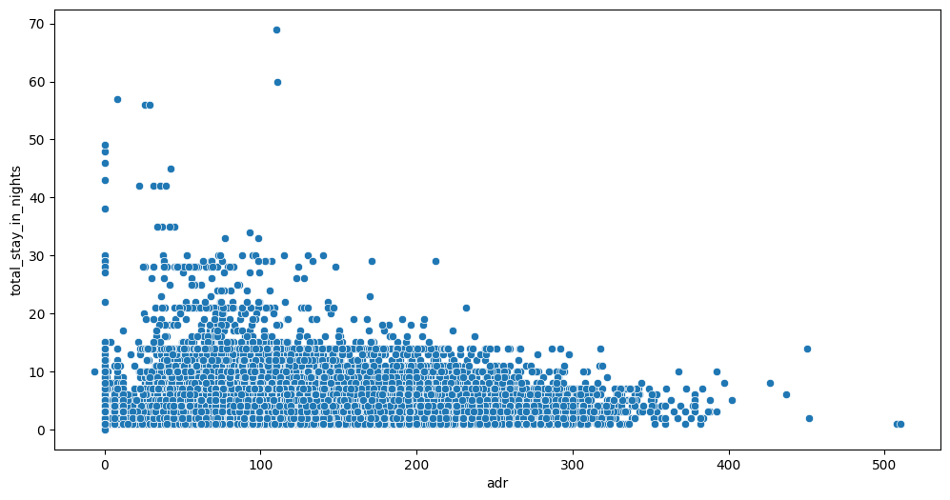
Chart 9 - Scatter Plot of Total Stay in Nights vs ADR

Slide 27
1. Why did you pick the specific chart?
To show comparison & affect of total stay days vs ADR
2. What is/are the insight(s) found from the chart?
Here, we found that if guest's stay days is getting decreased, ADR is getting high

Slide 28
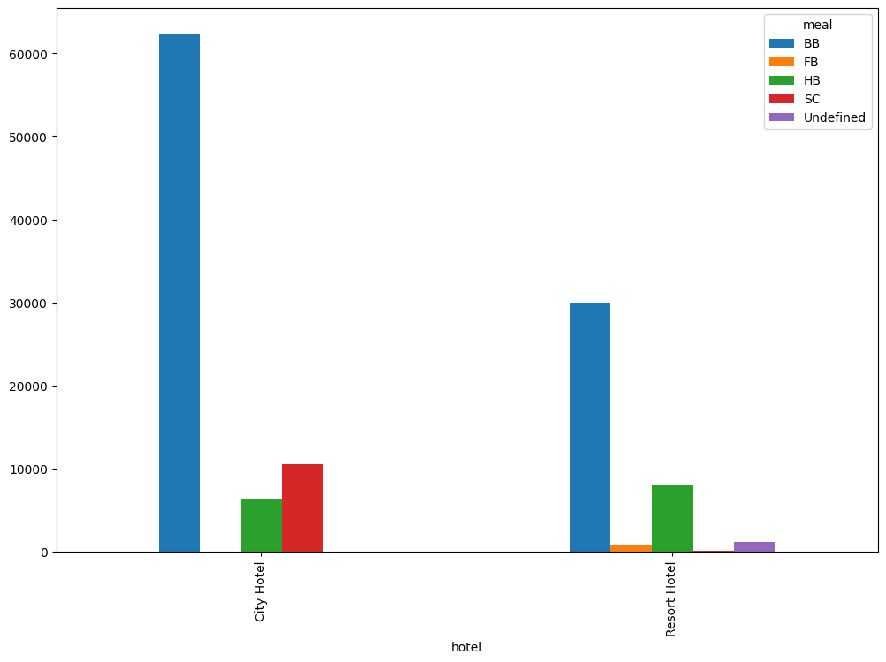
Chart - 10 - Meal Distribution by Hotel Type in a Bar Chart

Slide 29
1. Why did you pick the specific chart?
To show the meal preference of the guest hotel-wise.
2. What is/are the insight(s) found from the chart?
As we can see, BB (Bed & breakfast) meal is most preferred by guests in both the hotels. So Hotel can give more delicious dishes in this meal to get customer repeat & attract new customer.

Slide 30
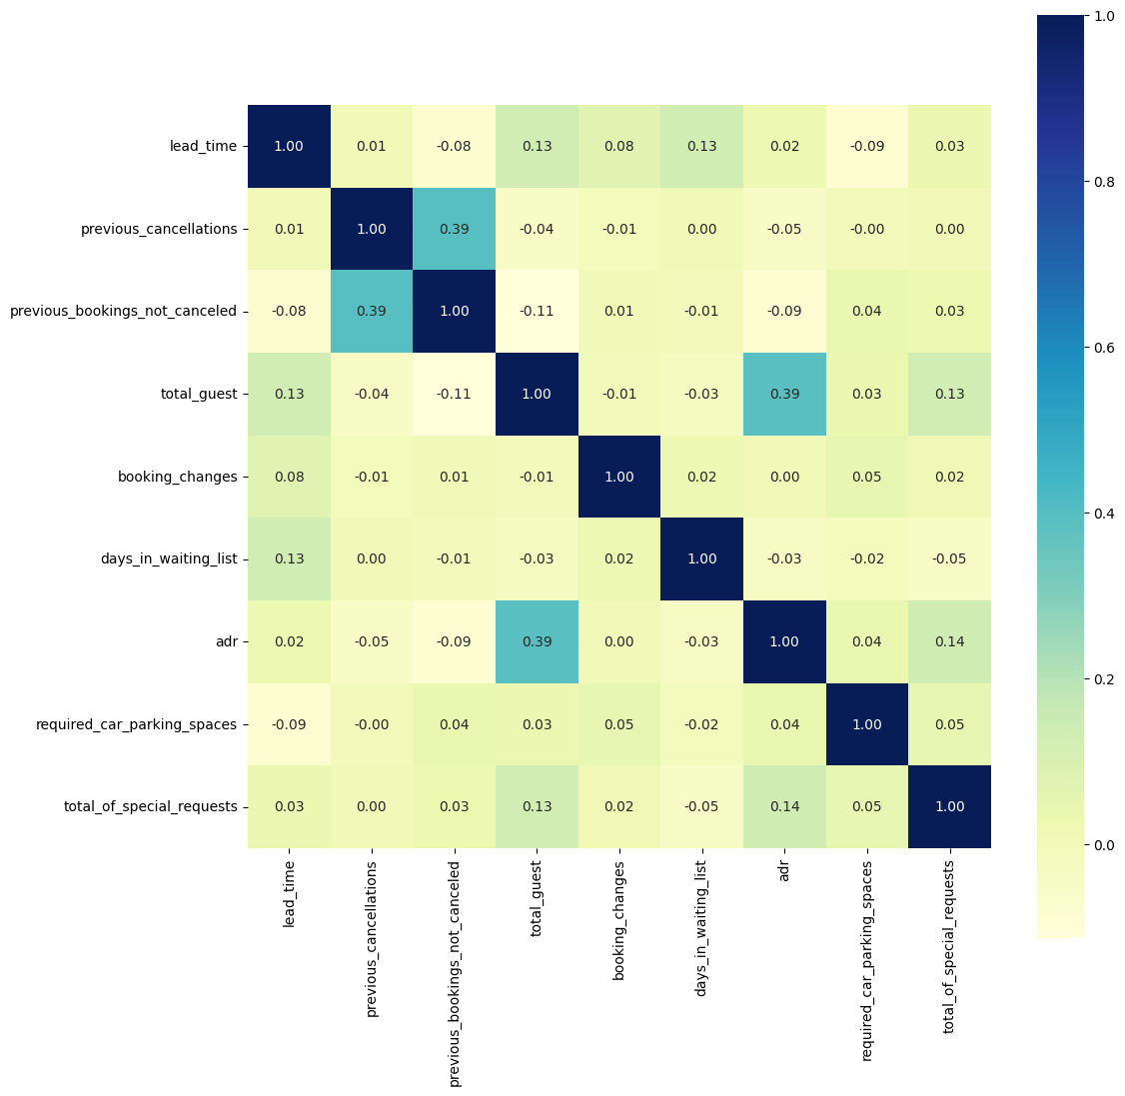
Chart 11 - Correlation Heatmap of Booking Features

Slide 31
1. Why did you pick the specific chart?
To understand the relationship between different numerical value
2. What is/are the insight(s) found from the chart?
Highest correlation value between axis is 39% positive & lowest corelation value between the axis is -9% negative.

Slide 32
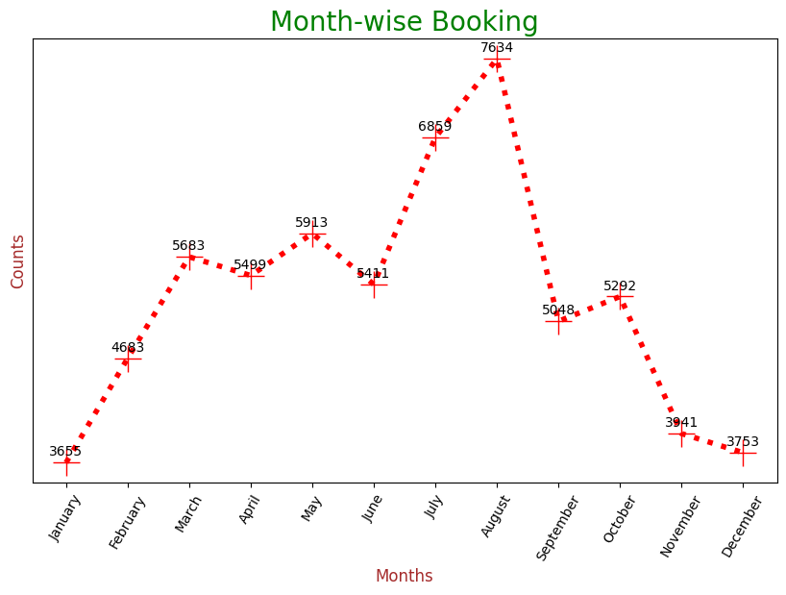
Chart 12- Month Wise booking on line chart

Slide 33
1. Why did you pick the specific chart ?
To specify the average ADR for both hotels
2. What is/are the insight(s) found from the chart?
As we can see the average ADR of City hotel is higher than Resort hotel, so the profit and revenue will be higher for city hotel
3. Will the gained insights help creating a positive business impact?
Are there any insights that lead to negative growth? Justify with specific reason.
here, we can do more advertising for City hotel to get more customer, which result higher profit

Slide 34
Solution to Business Objective
What do you suggest the client to achieve Business Objective ?
Explain Briefly.
Business objective attained as follows:
1.For hotel business to flourish few things which we need to consider is high revenue generation, customers satisfaction and employee retention.
2.We are able achieve the same by showing the client which are the months which are high in revenue generation by pie chart distribution
3.Increasing the revenue achieved by bar chart distribution of which type room are most reserved and what are the months likely for visitors
4.So for these the client can be well prepare in advance so that minimum grievances would be faced by clients in long run and would help in further enhancement of their hospitality.
5.Outliers like higher the visitor then adr has reduced drastically was shown in scattered plot so in off season client can engage with offices for bulk booking this will also help extra revenue generation
6.We are able to show the trend of arrivals of visitor at client locations through which client engaged visitor well advance for there entertainment and leisure activities
7.We where also able to co relate the values showing the max and min percentage between them so that the percentage lying those numbers can be enhanced by various medium

Slide 35
Conclusion
1.City Hotel seems to be more preferred among traveler's and it also generates more revenue & profit.
2.Most number of bookings are made in July and August as compared rest of the months.
3.Room Type A is the most preferred room type among traveler's.
4.Most number of bookings are made from Portugal & Great Britain.
5.Most of the guest stays for 1-4 days in the hotels.
6.City Hotel retains more number of guests.
7.Around one-fourth of the total bookings gets cancelled. More cancellations are from City Hotel.
8.New guest tends to cancel bookings more than repeated customers.
9.Lead time, number of days in waiting list or assignation of reserved room to customer does not affect cancellation of bookings.
10.Corporate has the most percentage of repeated guests while TA/TO has the least whereas in the case of cancelled bookings TA/TO has the most percentage while Corporate has the least.
11.The length of the stay decreases as ADR increases probably to reduce the cost.

